Slide 1
AUTO INSURANCE CLAIM FRAUD DETECTION
CAPSTONE PROJECT
PRESENTED BY
M.SURYA TEJA
BATCH 121
ENROLL ID -4414

Slide 2
CONTENTS
Problem Statement
Client Requirements or Objectives
About the Data
Exploratory Data Analysis with Insights
Challenges Faced
How I Overcome Challenges
Feature Engineering
Techniques Used
Models Used and Evaluation Metrics
Learning Curves
Best Model
Pattern Extraction
Deployment using Streamlit in Streamlit Cloud

Slide 3
PROBLEM STATEMENT
Insurance Fraud Claims :- Insurance Fraud Claim refers to any Insurance Claim with Improper Payment from Customer to Insurer (i.e., Insurance Company)
CLIENT :-
Our Client is an Insurance Company , which have a Business Problem of Fraud Claims that leads to excessive Leakages So that Our Client wants to Find the Fraudulent ones before even processing the claims to allocate costs appropriately. There are Two main Reasons for the Claims Motor Insurance and Health Insurance.
These are the segments that have seen a spurt in fraud. Frauds can be classified into following Categories
Sources : Sources Can be Policy Holders ,Intermediary (i.e., Who are refering the policy to Customers) and Internal (i.e., Employees who working in that Domain).This Problem is more Critical from Internal control framework point of view.
b. Nature point of view : Nature Point Of View can refers to application, Inflation , Identity, Fabrication(i.e., Claiming more amount than what they spent), staged/contrived/induced accidents (i.e., Doing Accidents Intentionally To Claim money)
This Kind of Fraud Claims affects the Lives of Innocent people as well as the Insurance industry not only this, Society get Lose their Interest On Insurance Companies which leads to the destruction of Insurance Companies. So, by Detecting the Fraud Claims we can helpful to Regular Customers and Intelligence Team. Predicting at the time of processing claims will reduce costs and minimize losses.

Slide 4
CLIENT REQUIREMENTS
Beyond Building a model to predict Fraudulent they also want to identify patterns in Fraud Claims which helps in turn to Company to take Action to initiate investigation to Identify if Fraud Exist and also to handle Fraudulent Cases while settling the claims. So they are Expected to Perform
Exploratory Data Analysis using visualizations - To get Insights which helps to Identify Fraudulent.
2. Build the analytical framework to predict if a claim is fraudulent or not - Evaluating the Model by Using F1- Score as Metric
3. Report the results/observations from learning curves - To Know Which model works Well in Predicting Fraud Claims.
4. Extract the top 20 patterns for fraudulent claims - Which helps to Understand the Company that Claim is Fraud or not Even Before they Processing the Claim.

Slide 5
ABOUT THE DATA
TABLE NAME | SIZE OF THE TABLE | DESCRIPTION
Train Claim | 28836 * 19 | In this Dataset they provided Information about Claim of the Customer like “Amount Of Total Claim” ,” Amount Of Injured Claim” ,” Amount Of Vehicle Claim”, “Incident Date” etc.
Train Demographics | 28836 * 10 | In this Dataset they provided Insured Details of Customer in 10 Features like “Location of Insured” “Insured Education”,” Age” etc.
Train Policy | 28836 * 10 | In this Dataset they provided Policy Details of Customer like Date of Policy Coverage , Loyalty Period, Policy Number, “Policy Deductible amount” etc.
Train Vehicle | 115344 * 3 | In this Dataset they Provided Details about Vehicle of Customer like Vehicle Attribute (contains 4 attributes ) and Values c
Train Target | 28836 *2 | The Dataset Contains “Customer ID” and “Reported Fraud”

Slide 6
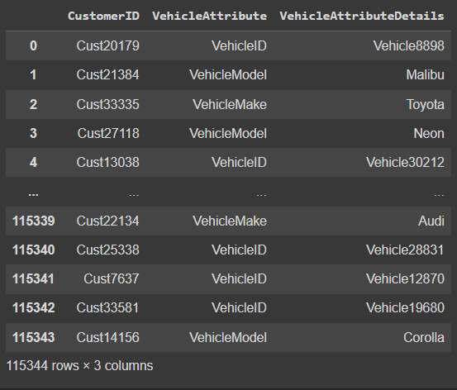
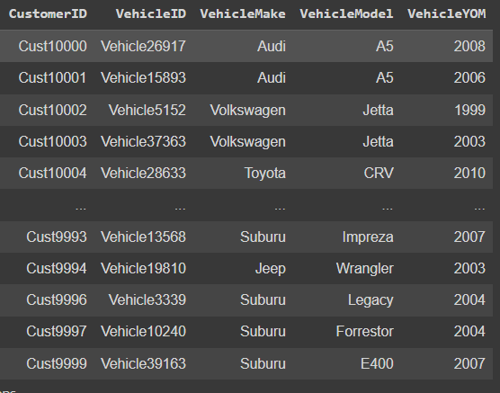
In these Dataset the Client given all the attributes about vehicle in One column but actually how the data looks like is for each Customer they given one Attribute name and its value so that each Customer repeated Four times with different Attribute name and Value. So I thought can we Convert the Dataset of Vehicle like Each Customer with there Four Attribute names as Column names and filling that with corresponding values. So I tried manually to convert it and later I found pivot() function Does this.
DataFrame
Index
Columns
Values
TrainVehicle.pivot(CustID,VehiAttr,Details)
This can be Done manually and Using unstack() also.
After Using Pivot my Dataset Size becomes (28836 *5)
After Understanding all these datasets , Combined all Using Merge() Function with on=CustomerID . Then I get one DataFrame with Size (28836 * 42) and These Dataset I used for my Further Preprocessing.
In Test they given 4 Datasets just like Train without Target Dataset. Did the Same thing on Test data about Combined all DataFrames using Merge() and I got DataFrame of size (28836 * 41).

Slide 7
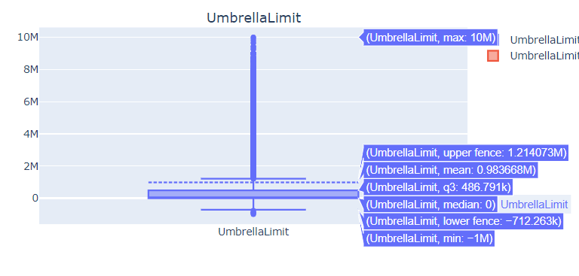
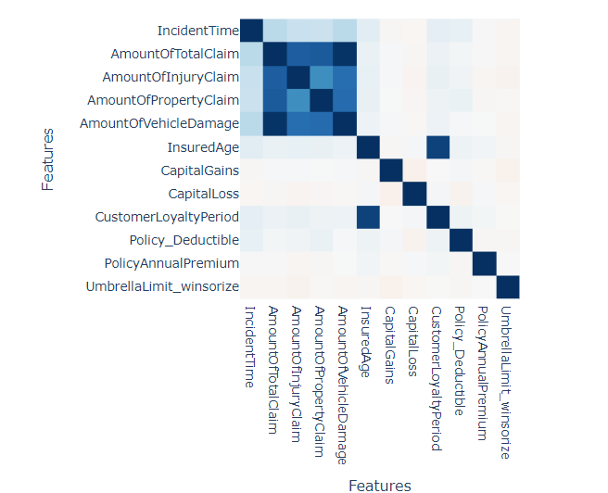
EXPLORATORY DATA ANALYSIS (EDA)
After did Some basic preprocessing like Converting Datatypes and Dropping High Cardinality Columns. Started Understanding Data by some simple Visualizations .
Numerical Data:
1. Started with Checking Extreme Values and Distribution of data Using Box plot and Histogram for Numerical Data. Maximum all Numerical Columns are Normally Distributed and no much Outliers in Data. But Umbrella Limit Column has Very Extreme Values they vary from (-1M to +10M) but mean is 0.98M and median is 0.
2. When I’m Checking For Correlation I found that there is a High Multi Collinearity Between “Amount Of Total Claim” , “Amount Of Injury Claim”,” Amount Of Vehicle Claim”, “Amount Of Property Claim”. This Multi Collinearity problem will effect my regression based models by giving more weights to that Columns like Logistic , SVC. So To avoid that problem I Dropped “Amount Of Total Claim” Column

Slide 8
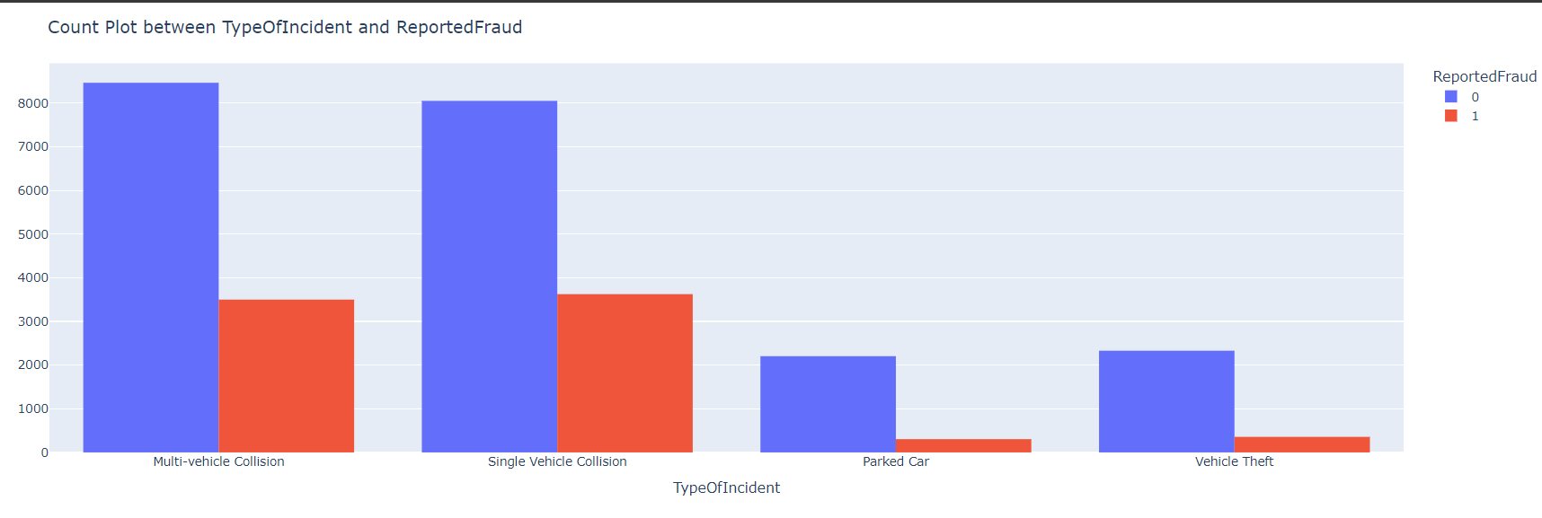
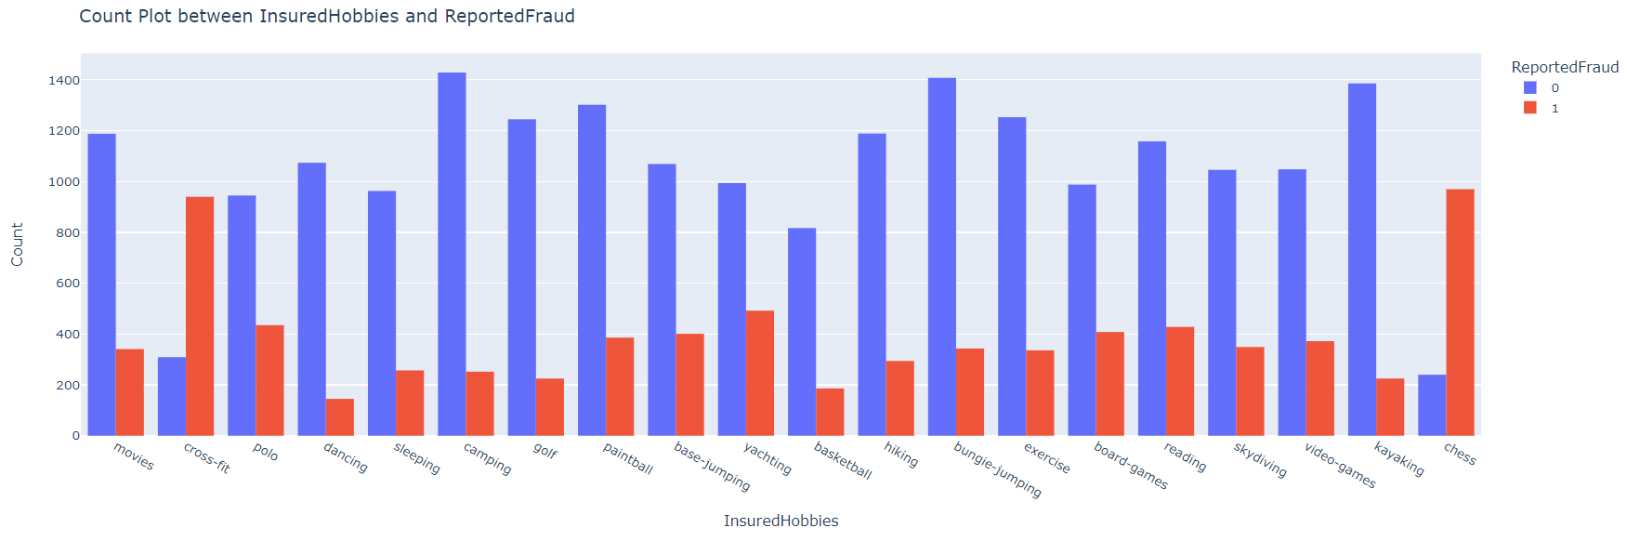
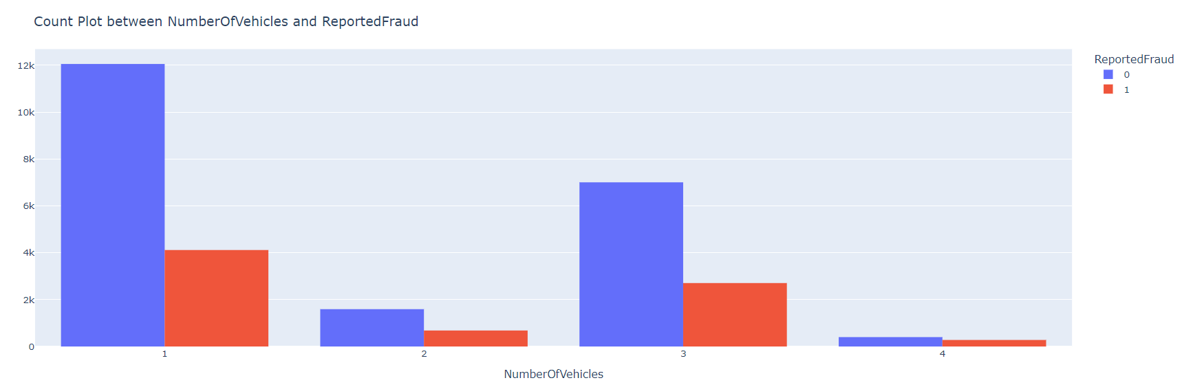
And I used Scatter plots to get any insights with respect to my
Target Column. But all columns are Distributed Evenly they do not follow any specific Pattern .
Type of Incident
Categorical Data:
When I’m Visualizing Categorical data then I found Some Features which have some impact on Target Variable.
Insured Hobbies
Number Of Vehicles

Slide 9
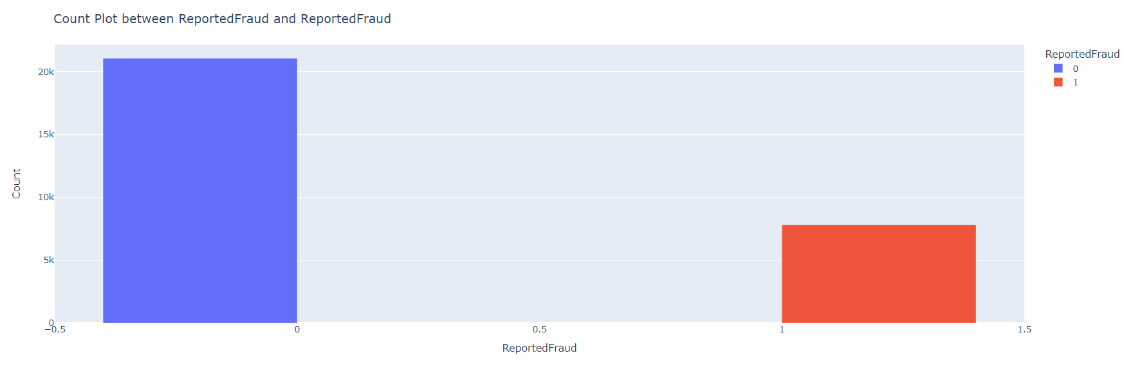
INSIGHTS
1. Outliers: We identified outliers in some variables, but mostly in Umbrella Limit Column which may indicate data measurement errors or extreme values. These outliers may have a significant impact on our analysis and should be carefully considered when modeling.
2. Class imbalance: We found that the distribution of the target variable is highly imbalanced, with a majority of the samples belonging to Non Fraud class. This may result in biased predictions and affect the accuracy of our model. We will explore various methods to address this issue, such as oversampling or under sampling.
3.Multi-collinearity :Our analysis revealed high collinearity
between some Independent Attributes, indicating that they are
highly correlated with each other. This may lead to model
instability and overfitting.
Reported Fraud
4. Columns impacting target: We found that some classes in Independent Attributes have a significant impact on the target variable. We will use these variables in our model to improve its performance.

Slide 10
CHALLENGES FACED
High Null Values : In Some Attributes like “Type Of Collision” (5162) , ”Property Damage” (10459),
“Police Report” (9805) Have very larger number of null values , If I drop it then we will loss
lot of Data.
Data Imbalance : In the given data we have seen that Class Imbalance is there Approximately 75% of Non –Frauds and only 25% of Frauds are there .
Outliers : In given Dataset we have seen that Some Attributes have Very Extreme Values which may lead to distract our models.
Cardinality : In our Dataset there are Some Columns like Incident location , Insured address , Vehicle model etc. all these have a large Number of Classes when we do Dummification for Categorical Attributes it may create a large size of dataset.
Uniformative Data : Data that does not provide any meaningful insights or patterns when analyzed because the data is too sparse, noisy, or lacks variability, It is challenge in data analysis and machine learning because it is difficult to extract useful information from it
6. Data quality issues: Your dataset may have missing values, outliers, or noise that make it difficult to achieve higher performance. In such cases, it is important use Different types of Models.

Slide 11
HOW I OVERCOME CHALLENGES
Handling High Null Values : Using Advanced Imputation Technique MICE (Multivariate Imputation by Chain Equation) Imputer.
Data Imbalance : Balancing the Data by generating Synthetic Data using SMOTE (Synthetic Minority Over sampling Technique) .
3.Handling Outliers : Using Winsorizing Technique . Winsorizing is a data preprocessing technique used to handle outliers in statistical models.
4.Handling Cardinality : By Feature Engineering , creating new features with less number of classes from high cardinality Attributes will reduce this Cardinality problem.
5.Uniformative Data : Combining two or more Features and Comparing with the target will give some Insights and Classify target Purely.

Slide 12
FEATURE ENGINEERING
In the Given Dataset DateTime Columns are there we cannot use directly into our model. So we need to Do some Feature Engineering for the Columns . What I do is I find the Gap between the Incident date and Date of policy Coverage and converted that gap into three categories named First Decade , Second Decade and Third Decade.
The Most Important Feature Engineering what I did is, I have taken some independent columns which impact my model as I mentioned in EDA . I have taken all the possible combinations from each class of all the Columns and I compared with the corresponding combination Target column values.
If any Combination have more than 50% 1’s(i.e., Frauds) in Target Column then I created a new column and filled with some new class as “Effective” , Otherwise “Non effective”. Then Some how I’m able to classify Fraud and Non Fraud better when Compared to previous Insights .
And I repeated this by taking another set of Independent Columns and added the previous Column what I created in it and repeated same Process. Now I got another Column, which classifies better than before one.
So again I tried the same Process with Incident details columns and previous new column then Created New column. When I visualize the Column it clearly maximum classifying the target.

Slide 13
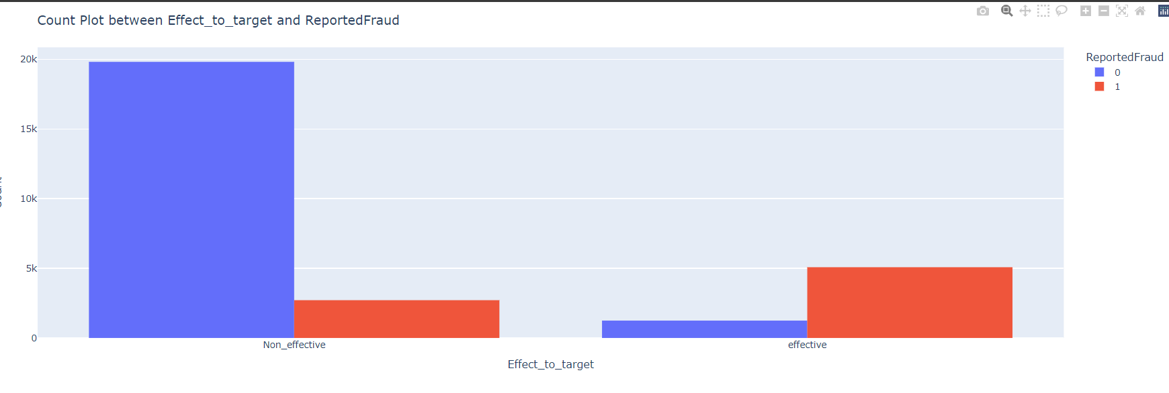
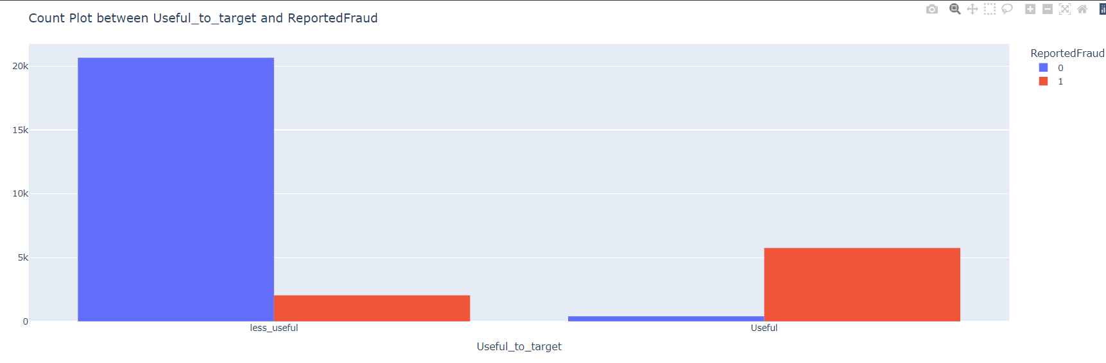
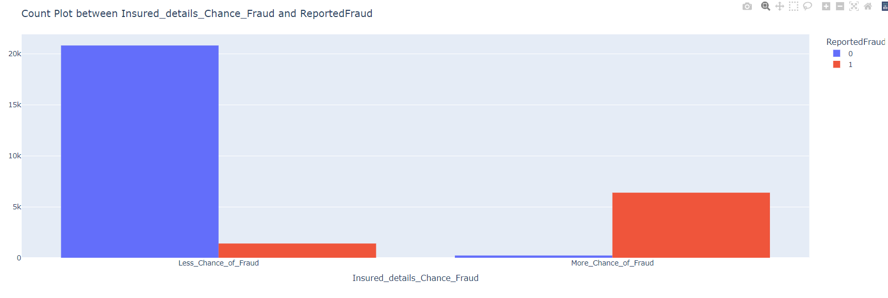
New Column 1 (Effect_to_the_Target)
New Column 2 (Useful_to_the_Target)
New Column 3 (Insured_details_Chance_Fraud)

Slide 14
TECHNIQUES USED
Winsorize Method is Used to Handle Outliers by replacing extreme values with the less extreme values.
Train Test Split Method is used to split the Training Data into Train and Validation data in the ratio 70 :30, which really required to validate our model how better it predicting on Unseen Data.
One Hot Encoding is used to Convert Categorical Data into Numerical Data by doing Dummification .
MICE Imputation is used to Impute Null values using Random Forest Model for both Numerical and Categorical Data.
Standard Scaler is a method which is used for scaling the data it ensures that all features are on a similar scale, preventing one feature from being more important than another . It also decreases the effect of Outliers on Model .
Cooks Distance is a Statistical Measure which is used to test whether the Extreme values are Influential Outliers or not .
SMOTE is a Up sampling Technique which is used to address the Class Imbalance Problem by generating Synthetic Data.
After Doing all the above Preprocessing Techniques on Data then Our Data is ready for Model Building.

Slide 15
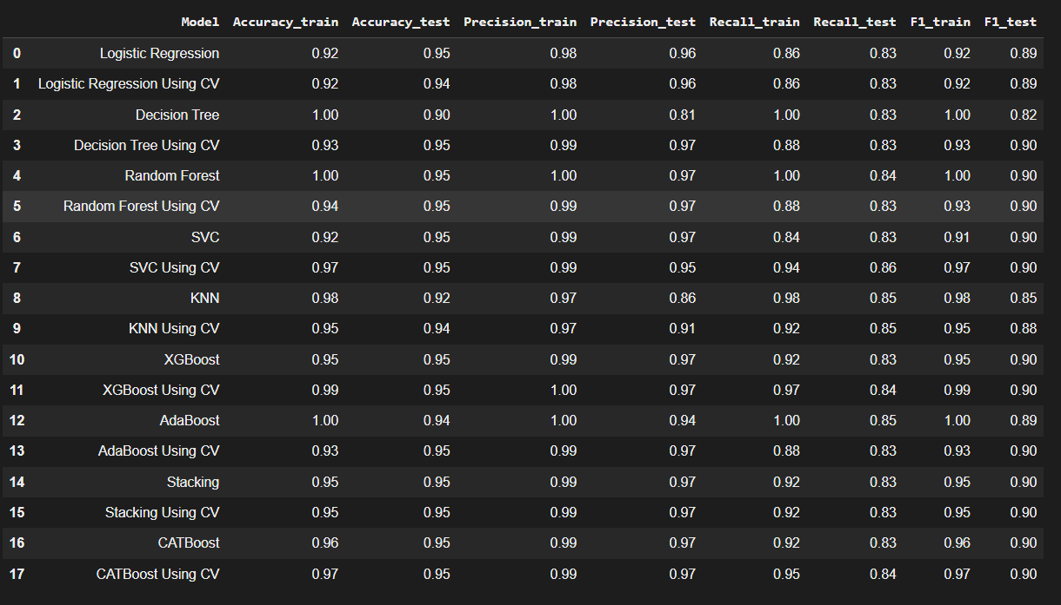
MODELS USED AND EVALUATION METRICS
I used many models from Basic like Logistic Regression to Advanced models like Boosting, Stacking, Artificial Neural Networks along with Hyper Parameter Tuning for each Model by Using “GRID SEARCH CROSS VALIDATION”.

Slide 16
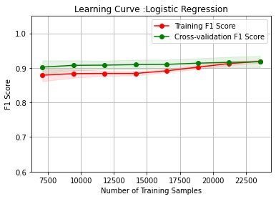
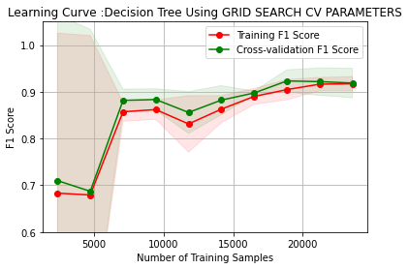
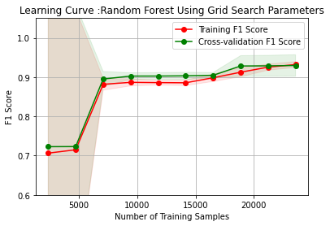
LEARNING CURVES
A learning curve is a visual representation of the relationship between a machine learning model's performance and the amount of training data used to train the model. The learning curve shows how the performance of the model improves or degrades as more data is used to train the model. A learning curve plots the training set size on the x-axis and some evaluation metric, such as F1 Score on the y-axis.
In many of my Models the learning curve suggests that the model initially overfits the training data but becomes more generalized as it is trained on more data, resulting in a smaller gap between the training and Cross validation curves by the end. This is a good sign, as it indicates that the model is neither underfitting nor overfitting the data, but is achieving a good balance between the two.
Logistics Regression
Decision Tree
Random Forest

Slide 17
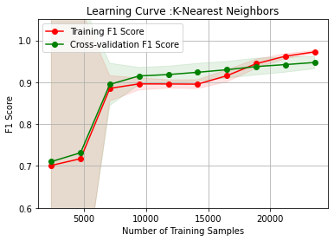
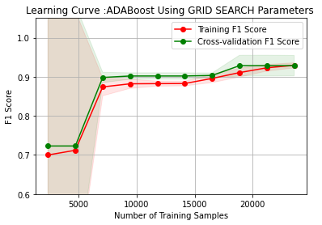
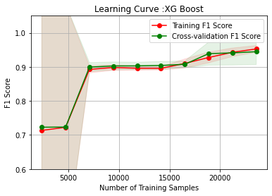
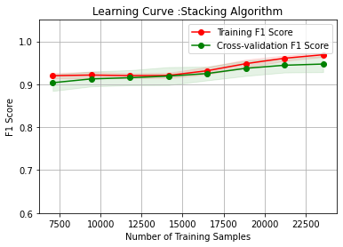
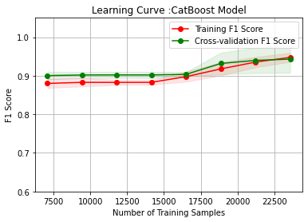
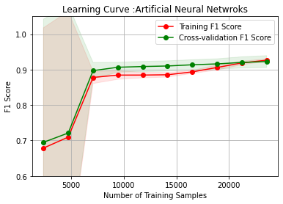
K Nearest Neighbor
Adaboost
Xgboost
Stacking
CatBoost
Artificial Neural Network

Slide 18
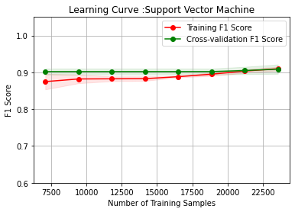
BEST MODEL
In all my Models “Support Vector Machine” performed very Well on my Training and Validation Data . I used SVC with Hyperparameters “C=1”, “Kernel= linear” , then I got my Evaluation Metric
F1 Score ( Training Data) = 91.04%
F1 Score (Validation Data) =89.63%
The Learning Curve indicates that model initially overfits the
training data but becomes more generalized as it is trained
on more data, resulting in a smaller gap between the training
and Cross validation curves by the end. This is a good sign,
as it indicates that the model is neither underfitting nor
overfitting the data, but is achieving a good balance
between the two.

Slide 19
Pattern Extraction Using Decision Tree
Pattern extraction is the process of identifying and extracting meaningful patterns or features from a dataset.
Different paths in the decision tree, each with a different set of conditions that lead to a different outcome. I Ranked them based on the Classification of Fraud or Not a Fraud .
So I Ranked them which path Classifies the Fraud in less Number of Steps. Some of the Paths of Decision Tree are
PATH 1
Insured Hobbies chess <= 0.500000
Type Of Incident Single Vehicle Collision <= 0.500000
Amount Of Injury Claim <= 6714.500000
Vehicle Make Honda <= 0.500000
Class 1
PATH 2
Insured Hobbies chess <= 0.500000
Insured Hobbies cross-fit <= 0.500000
Severity Of Incident Minor Damage <= 0.500000
Class 0
Insured Occupation exec-managerial <= 0.500000
Number Of Vehicles_4 <= 0.500000

Slide 20
PATH 3
Insured Hobbies chess <= 0.50
Type Of Incident Single Vehicle Collision <= 0.50
Amount Of Injury Claim <= 177.0
Class 1
Customer Loyalty Period <= 384.0
Police Report YES <= 0.50
PATH 4
Insured Hobbies chess <= 0.50
Insured Hobbies cross-fit <= 0.50
Class 0
Insured Occupation other-service <= 0.50
Vehicle Model Wrangler <= 0.500000
Type Of Collission Rear Collision <= 0.50
PATH 5
Insured Hobbies chess <= 0.50
Type Of Incident Single Vehicle Collision <= 0.50
Class 1
Amount Of Injury Claim <= 6714.50
Vehicle Make Honda <= 0.50
Vehicle Model Tahoe <= 0.50

Slide 21
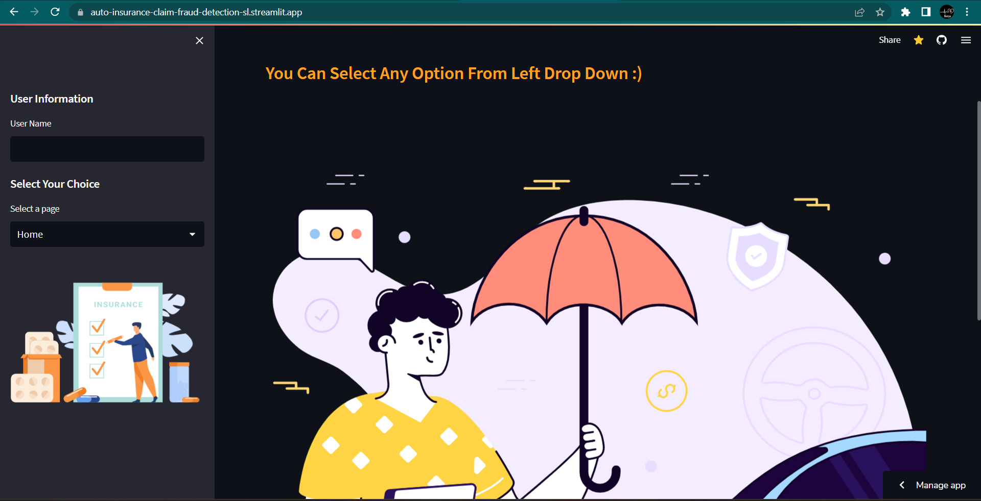
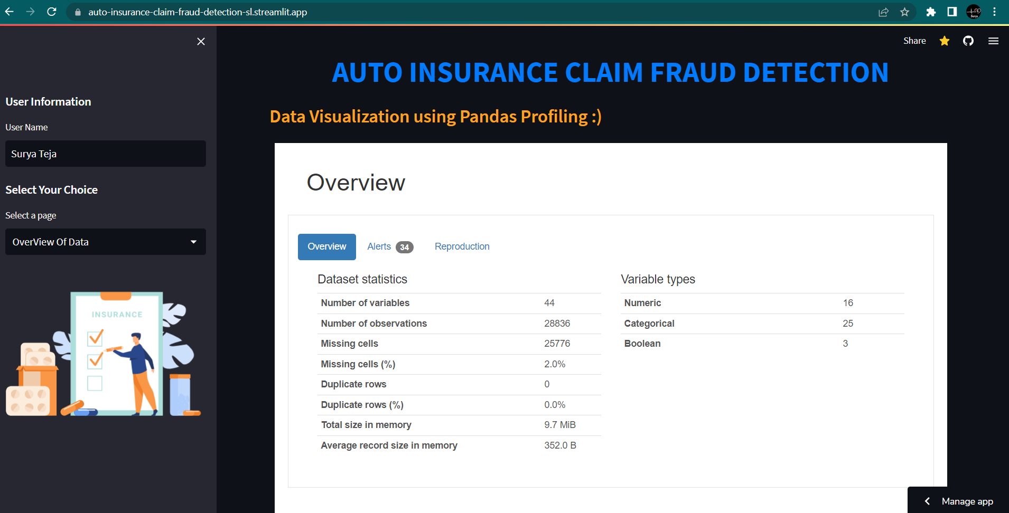
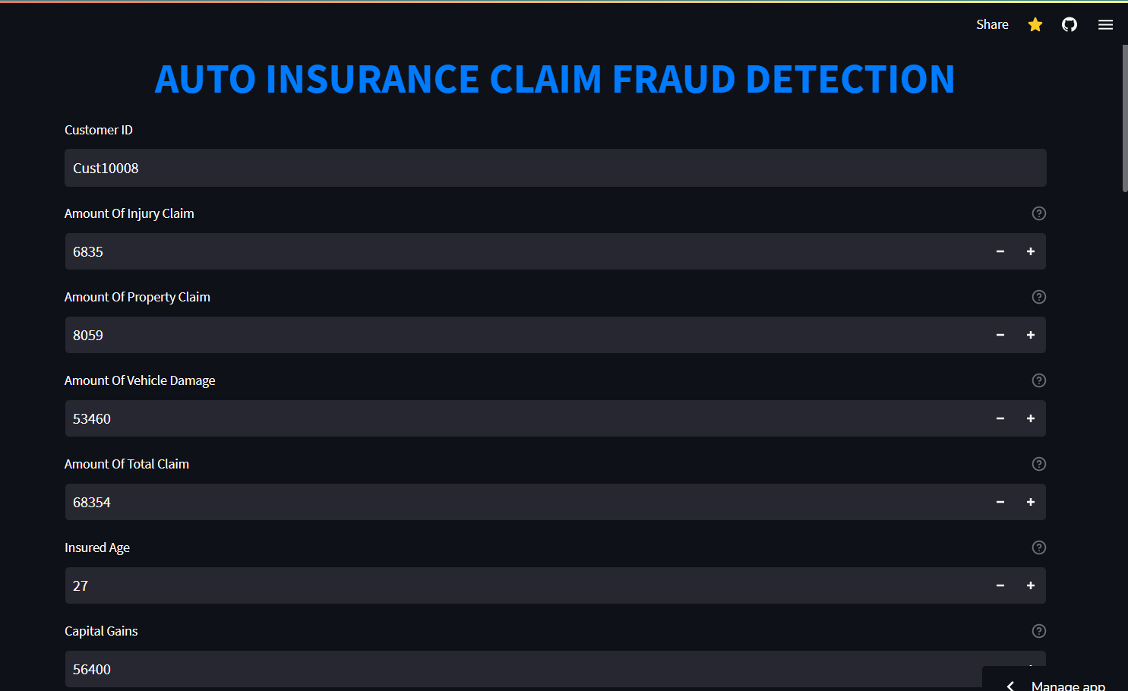
DEPLOYMENT USING STREAMLIT IN STREAMLIT CLOUD
As part of this project, we developed a user-friendly and interactive interface using Stream lit, a popular open-source Python framework for building data science applications ,Later deployed our Stream lit application using
Stream lit Cloud, a platform for deploying and sharing data science and machine learning applications. With Stream lit Cloud, we were able to quickly deploy our application and share it with others, allowing them to interact with our data analysis and gain valuable insights

Slide 22
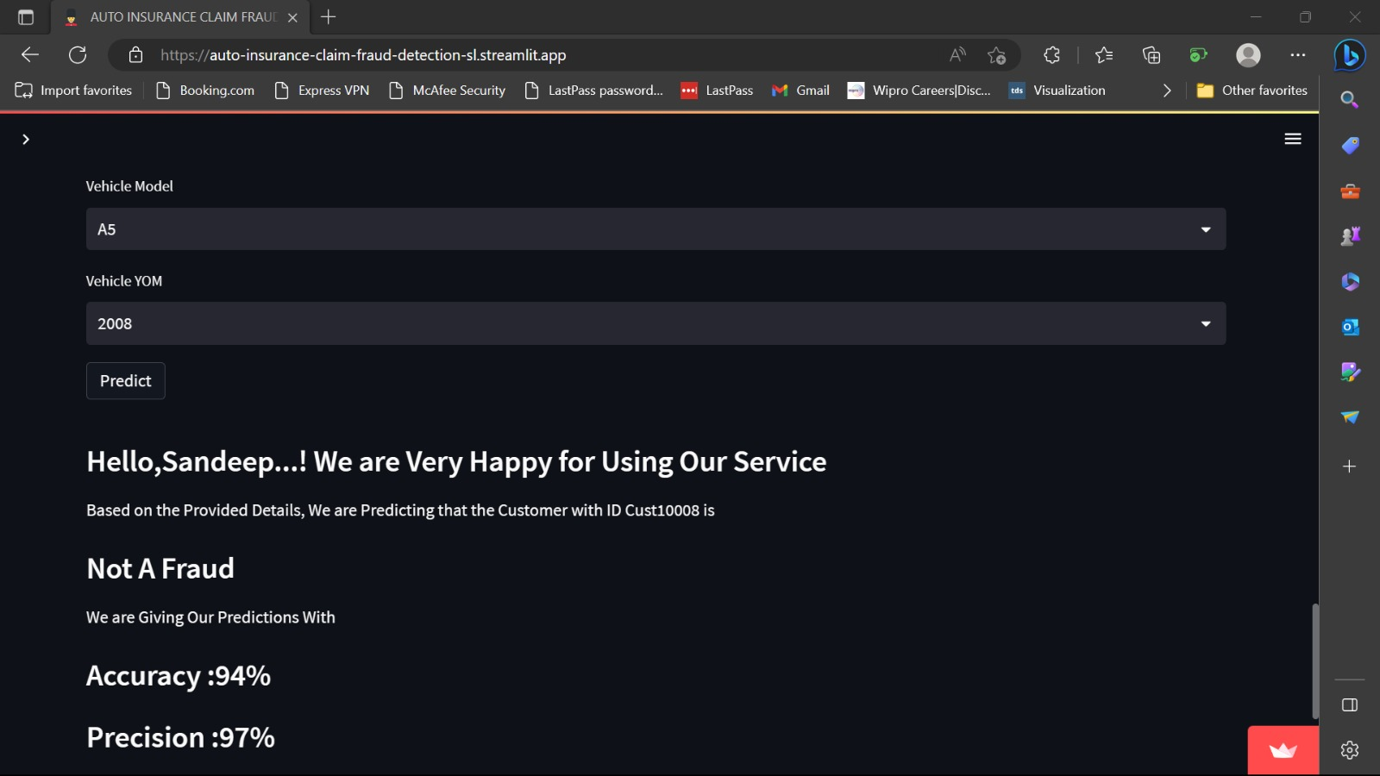
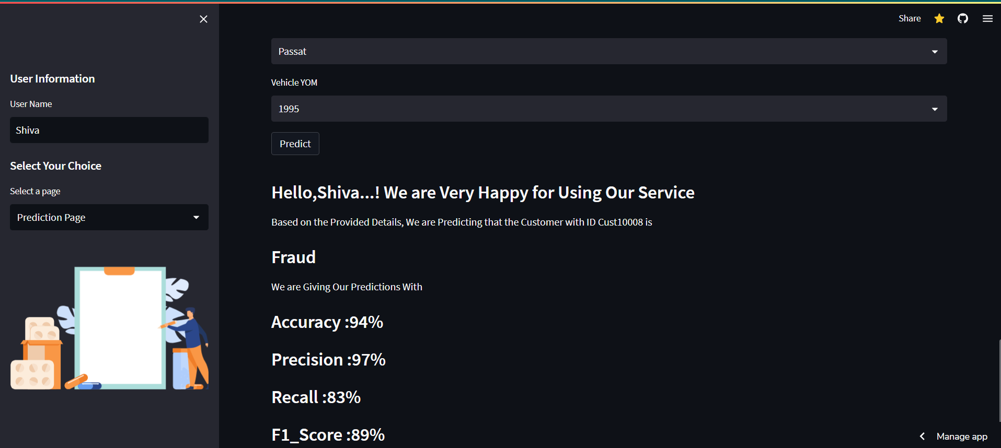
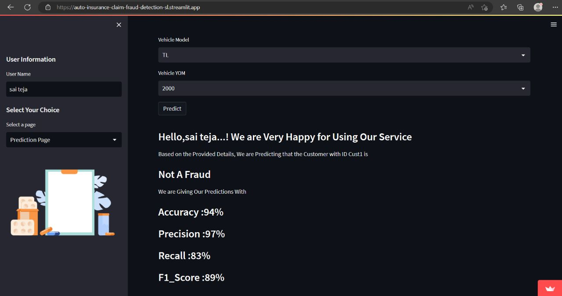
I have Shared this Application Link to my Friends and asked to see what are the predictions they got.
I am sharing my GitHub and Stream lit Application Link here.
Application Link : Auto Insurance Claim Fraud Detection Application
GitHub Repository : github-Auto Insurance Fraud Detection

Slide 23


